Slide 1
SIC030 - PPT - SESI ke 3 Sistem Perdagangan Elektronik
Pengantar Perdagangan Elektronik :
Struktur dan Model EC
M HANIF JUSUF ST MKOM

Slide 2
Learning Objectives
Define electronic commerce (EC) and describe its various categories.
Describe and discuss the content and framework of EC.
Describe the major types of EC transactions.
Describe some EC business models.

Slide 3
Learning Objectives (cont.)
Describe the benefits of EC to organizations, consumers, and society.
Describe the limitations of EC.
Describe the role of the digital revolution in EC.
Describe the contribution of EC to organizations responding to environmental pressures.

Slide 4
E-commerce Business Models
Business models—a method of doing business by which a company can generate revenue to sustain itself
Examples:
Name your price
Find the best price
Dynamic brokering
Affiliate marketing

Slide 5
E-commerce Business Plans and Cases
Business plan: a written document that identifies the business goals and outlines the plan of how to achieve them
Business case: a written document that is used by managers to garner funding for specific applications or projects; its major emphasis is the justification for a specific investment

Slide 6
Structure of Business Models
Business model: A method of doing business by which a company can generate revenue to sustain itself

Slide 7
Structure of Business Models (cont.)
Revenue model: description of how the company or an EC project will earn revenue
Sales
Transaction fees
Subscription fees
Advertising
Affiliate fees
Other revenue sources

Slide 8
Structure of Business Models (cont.)
Value proposition: The benefits a company can derive from using EC
search and transaction cost efficiency
complementarities
lock-in
novelty
aggregation and interfirm collaboration

Slide 9
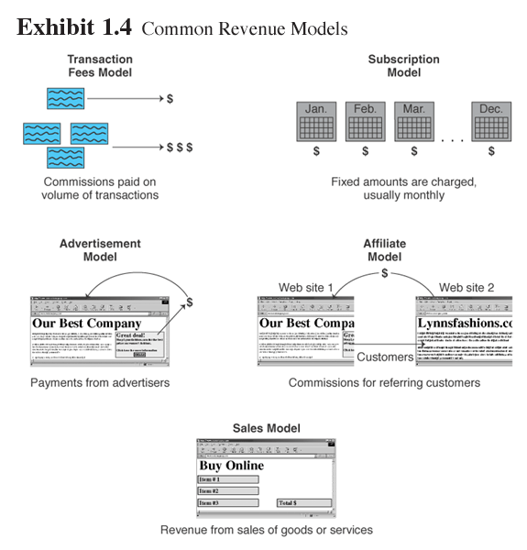
Exhibit 1.4: Common Revenue Models

Slide 10
Typical Business Models in EC
Online direct marketing
Electronic tendering systems
tendering (reverse auction): model in which a buyer requests would-be sellers to submit bids, and the lowest bidder wins
Name your own price: a model in which a buyer sets the price he or she is willing to pay and invites sellers to supply the good or service at that price

Slide 11
Typical Business Models in EC (cont.)
Affiliate marketing: an arrangement whereby a marketing partner (a business, an organization, or even an individual) refers consumers to the selling company’s Web site
Viral marketing: word-of-mouth marketing in which customers promote a product or service to friends or other people

Slide 12
Typical Business Models in EC (cont.)
Group purchasing: quantity purchasing that enables groups of purchasers to obtain a discount price on the products purchased
SMEs: small to medium enterprises
Online auctions

Slide 13
Typical Business Models in EC (cont.)
Product and service customization
customization: creation of a product or service according to the buyer’s specifications
Electronic marketplaces and exchanges
Value-chain integrators
Value-chain service providers

Slide 14
Typical Business Models in EC (cont.)
Information brokers
Bartering
Deep discounting
Membership
Supply chain improvers
Business models can be independent or they can be combined amongst themselves or with traditional business models

Slide 15
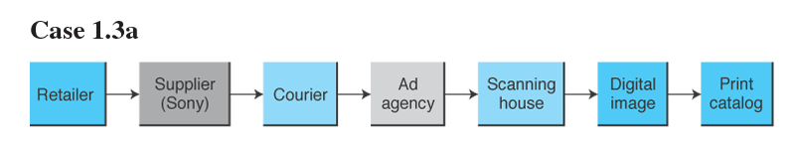
Example of Supply Chain Improver
Orbis Group changes a linear physical supply chain to an electronic hub
Traditional process in the B2B advertising field

Slide 16
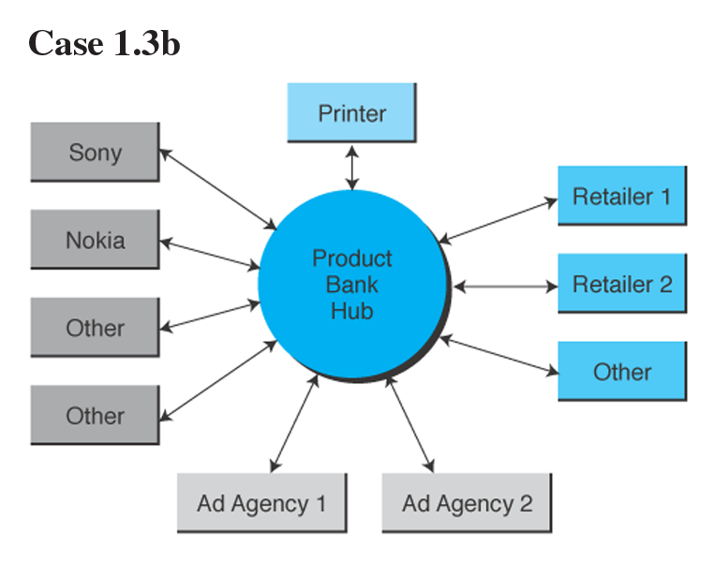
Example of Supply Chain Improver (cont.)
ProductBank simplifies this lengthy process changing the linear flow of products and information to a digitized hub

Slide 17
Benefits of EC
Benefits to organizations
Global reach
Cost reduction
Supply chain improvements
Extended hours: 24/7/365
Customization
New business models
Vendors’ specialization
Rapid time-to-market
Lower communication costs
Efficient procurement
Improved customer relations
Up-to-date company material
No city business permits and fees
Other benefits

Slide 18
Benefits of EC (cont.)
Benefits to consumers
Ubiquity
More products and services
Cheaper products and services
Instant delivery
Information availability
Participation in auctions
Electronic communities
“Get it your way”
No sales tax

Slide 19
Benefits of EC (cont.)
Benefits to society
Telecommuting
Higher standard of living
Hope for the poor
Availability of public services

Slide 20
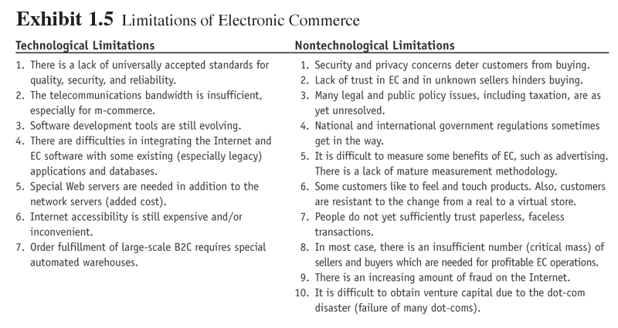
Limitations of EC

Slide 21
Barriers of EC
Security
Trust and risk
Lack of qualified personnel
Lack of business models
Culture
User authentication and lack of public key infrastructure
Organization
Fraud
Slow navigation on the Internet
Legal issues

Slide 22
The Digital Revolution
Digital economy: An economy that is based on digital technologies, including digital communication networks, computers, software, and other related information technologies; also called the Internet economy, the new economy, or the Web economy

Slide 23
The Digital Revolution (cont.)
A global platform over which people and organizations interact, communicate, collaborate, and search for information
Includes the following characteristics:
A vast array of digitizable products
Consumers and firms conducting financial transactions digitally
Microprocessors and networking capabilities embedded in physical goods

Slide 24
New Business Environment
Customers are becoming more powerful
Created due to advances in science occurring at an accelerated rate
Results in more and more technology
Rapid growth in technology results in a large variety of more complex systems

Slide 25
New Business Environment (cont.)
Characteristics in the business environment
A more turbulent environment with more business problems and opportunities
Stronger competition
Need for organizations to make decisions more frequently
A larger scope for decisions because more factors
More information and/or knowledge needed for making decisions

Slide 26
Environment-Response-Support Model
Critical response activities
traditional actions such as lowering cost and closing unprofitable facilities
introduce innovative actions such as customizing or creating new products or providing superb customer service

Slide 27
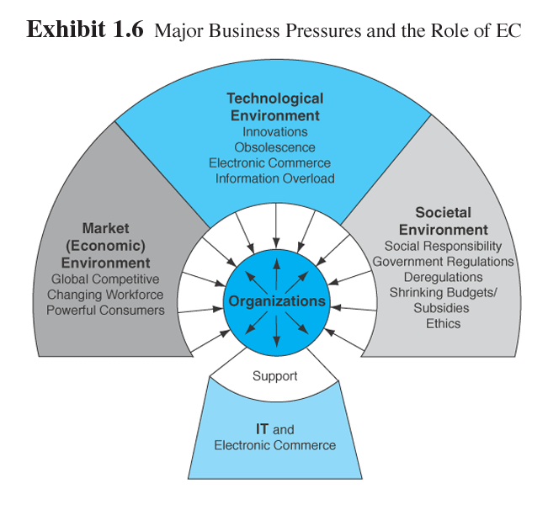
Exhibit 1.6: Major Business Pressures and the Role of EC

Slide 28
Major Business Pressures
Strong competition
Global economy
Regional trade agreements (e.g. NAFTA)
Extremely low labor cost in some countries
Frequent and significant changes in markets
Increased power of consumers
Market and
economic
pressures

Slide 29
Major Business Pressures (cont.)
Changing nature of workforce
Government deregulation of banking and other services
Shrinking government subsidies
Increased importance of ethical and legal issues
Increased social responsibility of organizations
Rapid political changes
Societal and
environmental
pressures

Slide 30
Major Business Pressures (cont.)
Rapid technological obsolescence
Increase innovations and new technologies
Information overload
Rapid decline in technology cost vs. performance ratio
Technological
pressures

Slide 31
Organizational Responses
Strategic systems
Continuous improvement efforts and business process reengineering—including business process reengineering (BPR)
Customer relationship management (CRM)—divided into the following areas
Operational CRM
Analytical CRM
Collaborative CRM

Slide 32
Organizational Responses (cont.)
Business alliances
Electronic markets
Reductions in cycle time and time-to-market
Cycle time reduction: Shortening the time it takes for a business to complete a productive activity from its beginning to end

Slide 33
Organizational Responses (cont.)
Empowerment of employees
Supply chain improvements
Mass customization: make-to-order in large quantities in an efficient manner
Mass customization: Production of large quantities of customized items

Slide 34
Organizational Responses (cont.)
Intrabusiness: from sales force automation to inventory
Knowledge management
Knowledge management (KM): The process of creating or capturing knowledge, storing and protecting it, updating and maintaining it, and using it

Slide 35
Putting It All Together
Task facing each organization is how to put together the components that will enable the organization to transform itself to the digital economy and gain competitive advantage by using EC
Many employ corporate portals
A major gateway through which employees, business partners, and the public can enter a corporate Web site

Slide 36
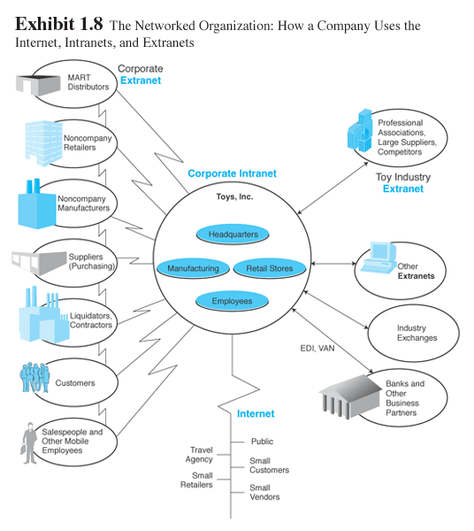
Exhibit 1.8: The Networked Organization

Slide 37
Managerial Issues
Is it real?
How should we evaluate the magnitude of the business pressures?
Why is B2B e-commerce so attractive?
There are so many EC failures—how can one avoid them?

Slide 38
Managerial Issues (cont.)
What should be my company’s strategy toward EC?
How do we transform our organization into a digital one?
What are the top challenges of EC?

Slide 39
Summary
Definition of EC and description of its various categories.
The content and framework of EC.
The major types of EC transactions.
The major business models.

Slide 40
Summary (cont.)
Benefits to organizations, consumers, and society.
Limitations of EC.
The role of the digital revolution.
The role of EC in combating pressures in the business environment.

Slide 41

Selesai

